Slide 1
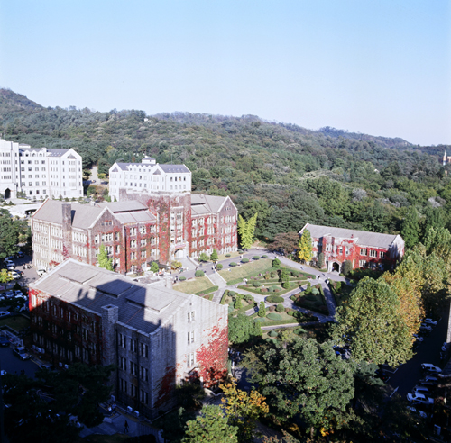
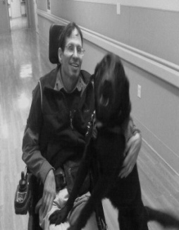
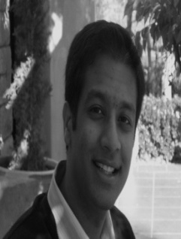
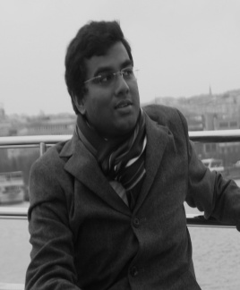
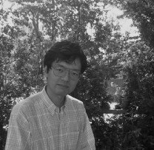
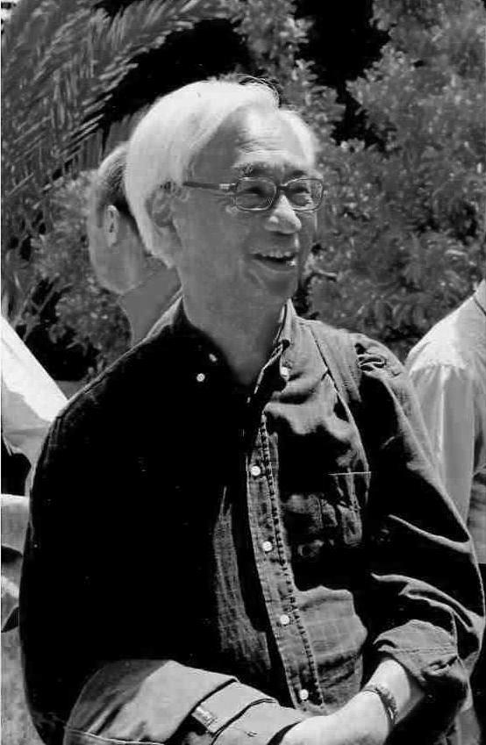
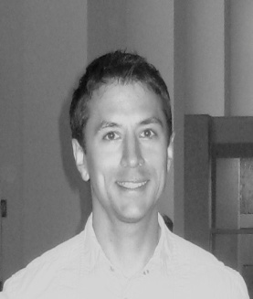
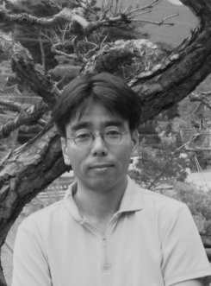
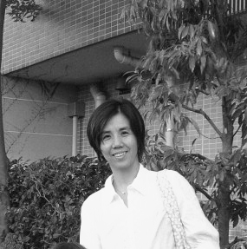
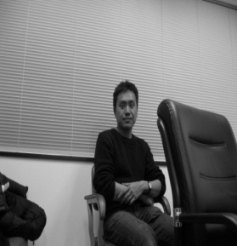
L-functions and Arithmetic
Oct 22-26, 2012
Dept. of Mathematics
Yonsei University
Seoul, South Korea
Invited Speakers
Robert Coleman(U.C. Berkeley, USA)
Samit Dasgupta (U.C. Santa Cruz, USA)
Mahesh Kakde(Kings College, UK)
Masato Kurihara (Keio Univ. Japan)
Thong Nguyen Quang Do(Besançon, France)
Romyar Sharifi(Univ. of Arizona, USA)
Yuichiro Taguchi(Kyushu Univ. Japan)
Takae Tsuji(Tokai Univ. Japan)
Seidai Yasuda (RIMS, Japan)
Organizers
Sunghan Bae(Kaist)
David Burns (Kings College, UK)
Masato Kurihara (Keio Univ. Japan)
Soogil Seo(Yonsei Univ.)
Sponsored by Yonsei Math BK21
ASARC of Kaist

